Slide 1
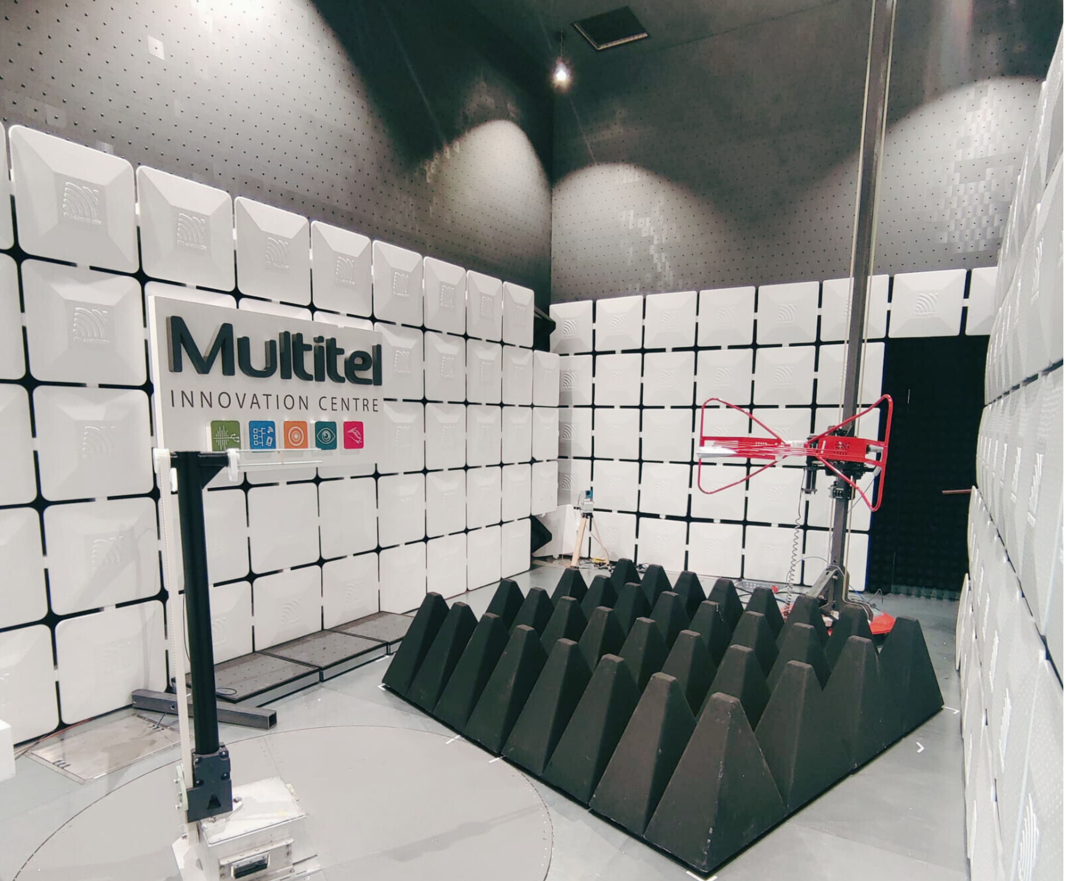
MULTITEL Innovation Centre
About us
Multitel's mission is, first and foremost, to help companies integrate new technologies more effectively into their products, processes and services, with a view to greater competitiveness and sustainable economic prosperity.
Thanks to their multi-disciplinary and complementary skills, our 100 enthusiastic researchers and collaborators can assist companies from the initial idea through to prototype production and beyond when it comes to TEF-Health.
Contact
Anne-Laure Cadji (TEF-Health Project Manager) cadji@multitel.be
Anne-Sophie Bridoux (Head of Computer Vision Group) bridoux@multitel.be
Mamadou Gueye (EMC & ETSI Test Lab Responsible) gueye@multitel.be
Facilities
Anechoic chamber for EMC testing of devices of 1,5 m diameter and 1 ton weight
Services
Expertise
AI Technological watch and guidance
AI Technical tests and Feasibility Study
AI Model Development & Improvement
AI and Optolectronics Prototyping
Dataset quality and data distribution assessment
AI Model performance evaluation
AI Model performance benchmark
EMC Testing for product development
Pre-certification for radiated emission & immunity
Data quality evaluation
Trustworthy AI
Marker-less human motion analysis

