Slide 1
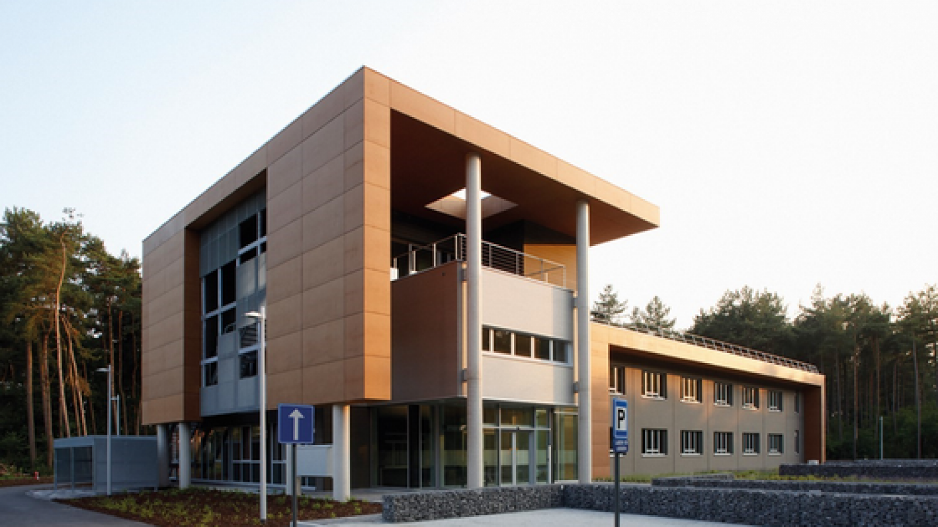
VITO
Contact
Bart Elen (Researcher)
bart.elen@vito.be
Tina Smets (Business Manager)
tina.smets@vito.be
www.vito.be
About us
VITO - The Flemish Institute for Technological Research (VITO) is an independent research organization based in Flanders, Belgium, focused on advancing sustainable development through scientific research and technological innovation. Established on June 12, 1991, VITO operates under the auspices of the Flemish government and aims to facilitate the transition to a sustainable society across various sectors, including energy, chemistry, materials, health, and land use
Expertise
Our services
VITO is very active in the field of the evaluation of AI as a medical device and AI in medical devices. VITO is and has been involved in European projects such as VIVALDY (Verification and Validation of AI-enabled systems), REALM (Real-world-data enabled assessment for health regulatory decision-making), and NoBoCap (Notified Body Increased Capacity). We build up plenty of expertise in:
- Fine grained AI performance evaluations
- Automated AI performance monitoring
- AI explainability evaluations
- AI robustness evaluations
AI evaluation services
Evaluation of medical AI using real-world Data and Synthetic Data to create a strong technical AI evaluation report.
AI evaluation trainings
Specialized training on how to thoroughly evaluate the performance of Medical AI models and create test reports for notified bodies.
AI monitoring
Semi-automated performance monitoring of the Medical AI deployed in the clinical practice, following PMS regulation.

