Slide 1
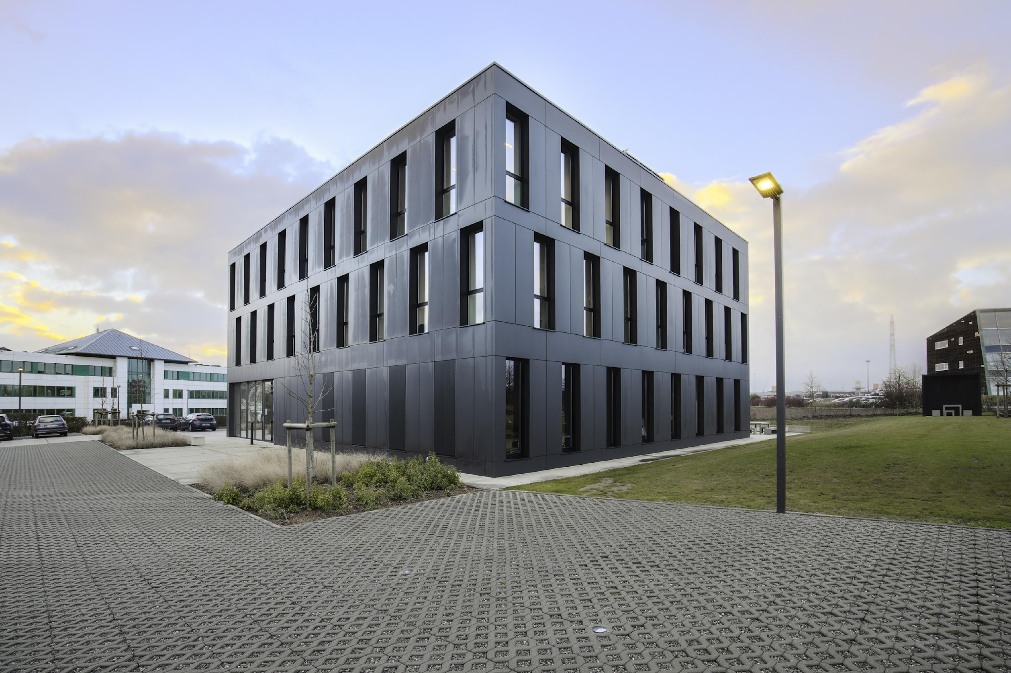
CETIC Research Centre
In the field of ICT, focusing on promoting economic development by transferring cutting-edge research results to businesses and SMEs.
CETIC integrates advanced technologies into products, processes, and services, enabling faster innovation, cost savings, green goals and accessing new markets.
Specializations: Software Engineering, Artificial Intelligence, Cybersecurity, Algorithmic Optimization, and the Internet of Things.
Key societal domains of application: health, smart mobility, energy, and manufacturing.
www.cetic.be
tef-health-services@cetic.be
Nikolaos Matskanis (Senior project manager)
nikolaos.matskanis@cetic.be
Maher Badri (Senior project manager)
maher.badri@cetic.be
TEF-Health Services
Quality Development - Hardware & Software Design
Quality Development - Evaluation of AI Software Quality
Quality Development - Escrow for AI-based Software
Quality Development - Cybersecurity
Algorithmic Development - Large-Scale Process Optimization
Needs Analysis - Technological Planning
Development Platforms to Simplify Your Processes
Data Science and AI
Anonymized health datasets
Statistical information on patient cohorts
Generation of Realistic Data for Effective Testing
Support and Development of Medical Data Analyses
IoT Interoperability Assessment for Enhanced Compatibility
Software environments preserving confidentiality
Embedded systems and IoT networks
Algorithmic and combinatorial Optimisation
Cyber Security

